Slide 1

Smart Helmet for Rider Safety Using Arduino
An IoT-based Accident Detection and Emergency Alert System
Hasibur Rahman Sun — 0112330199
Nafis Iqbal Neloy — 0112330617
Md. Mishkatul Bary — 0112330669
Abdullah Al Muhaimin — 0112330641
Farjana Akter — 0112330657
Jannatul Ferdaous — 0112330670

Slide 2

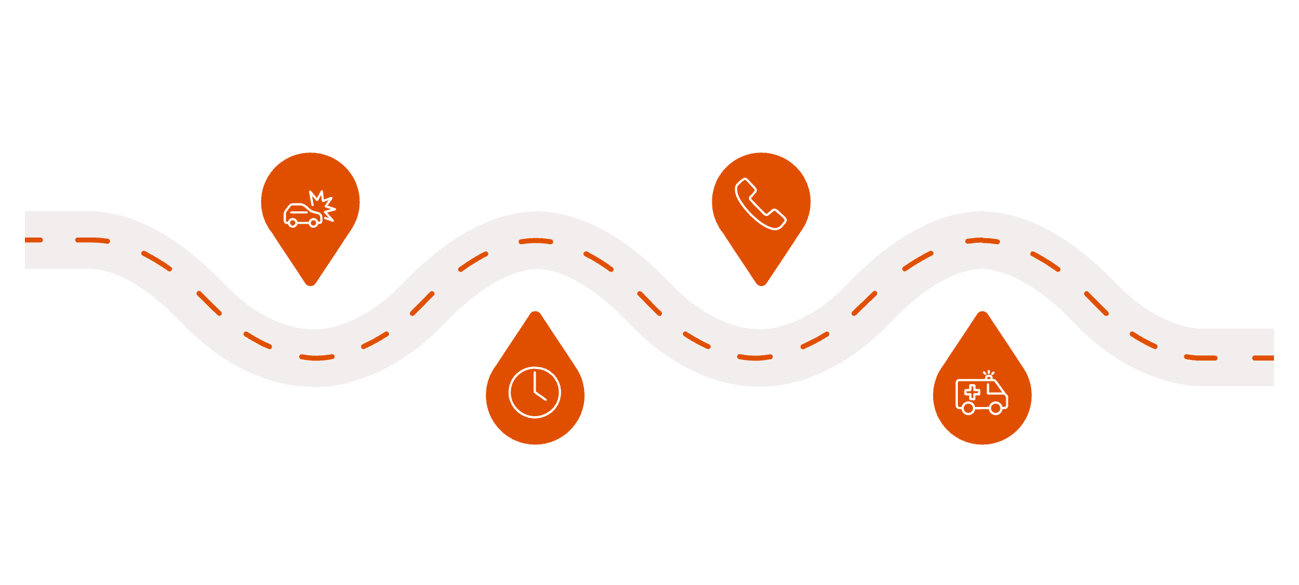
Introduction & Problem Statement
Accidents become critical when emergency aid is delayed.
No automatic crash detection on many helmets.
Riders may be incapacitated and unable to call for help.
Crash
Call Placed
Impact occurs; rider may be incapacitated
Manual call made once able or noticed
Detection Delay
Emergency Arrival
No automatic alert; valuable minutes lost
Help reaches scene after significant delay

Slide 3

Project Objectives
Automatic Detection
Detect impacts and abnormal motion
Reliable Alerts
Send SOS with GPS to contacts
Low Cost
Affordable, wearable electronics

Slide 4

System Overview
Outputs
Helmet Sensors
SOS & Call actions
MPU6050 & SW-420
Emergency Contact
Helmet SOS System
ESP32 Controller
Edge data processing
Alert recipient
Smartphone
Bluetooth Link
GPS & messaging
Wireless transmit to phone

Slide 5
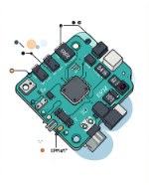
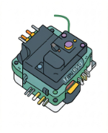
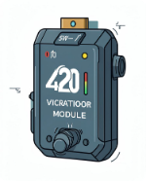
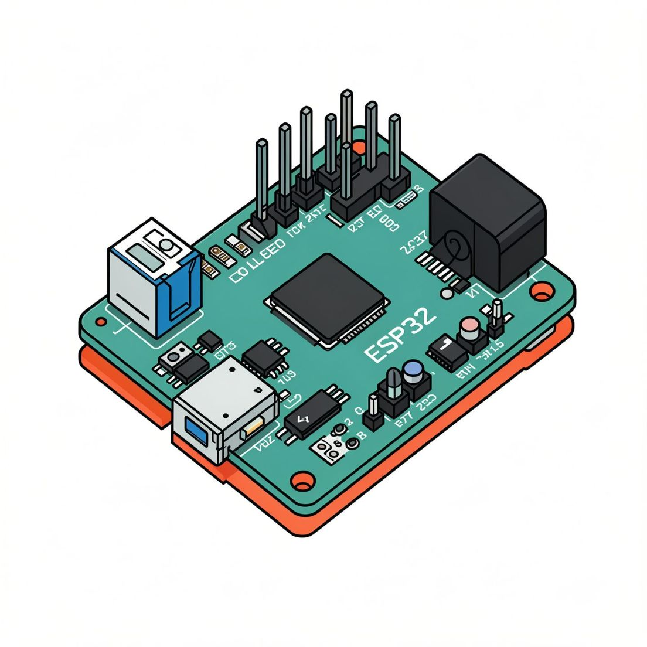
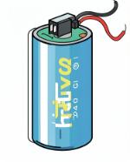
Hardware Components
ESP32
MPU6050
SW-420
Main microcontroller and processor for the system.
Accelerometer & gyro for tilt and impact detection.
Vibration/impact confirmation sensor.
Battery + TP4056
Portable power and safe charging management.

Slide 6
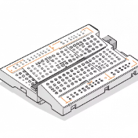

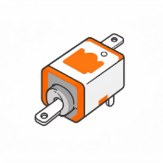
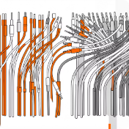

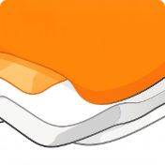
Structural & Mechanical Components
Breadboard
LEDs
Buzzers
Connecting Wires
For prototyping circuit connections safely and efficiently.
Visual indicators for system status (e.g., active, alert, low battery).
Audible alerts for the rider, confirming actions or warnings.
To establish secure electrical connections between all components.
Insulation Materials
Foam Padding
For secure sensor mounting and rider comfort within the helmet.
Heat shrink for protecting connections and preventing short circuits.

Slide 7

Accident Detection Technology
MPU6050
SW-420
ESP32 Alert

Slide 8
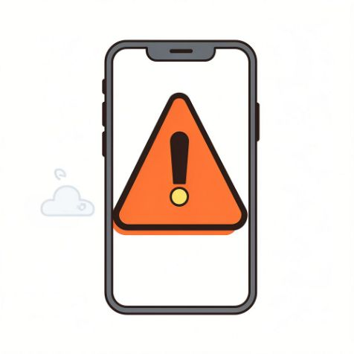




Smart Features
Accident Detection
Real-Time SOS
GPS Sharing
Bluetooth Connectivity
Automatic, threshold-based detection.
Immediate alert with location.
Accurate coordinates sent to contacts.
Low-energy BLE link to smartphone.
False Alarm Cancellation
10s confirmation window for rider override.

Slide 9
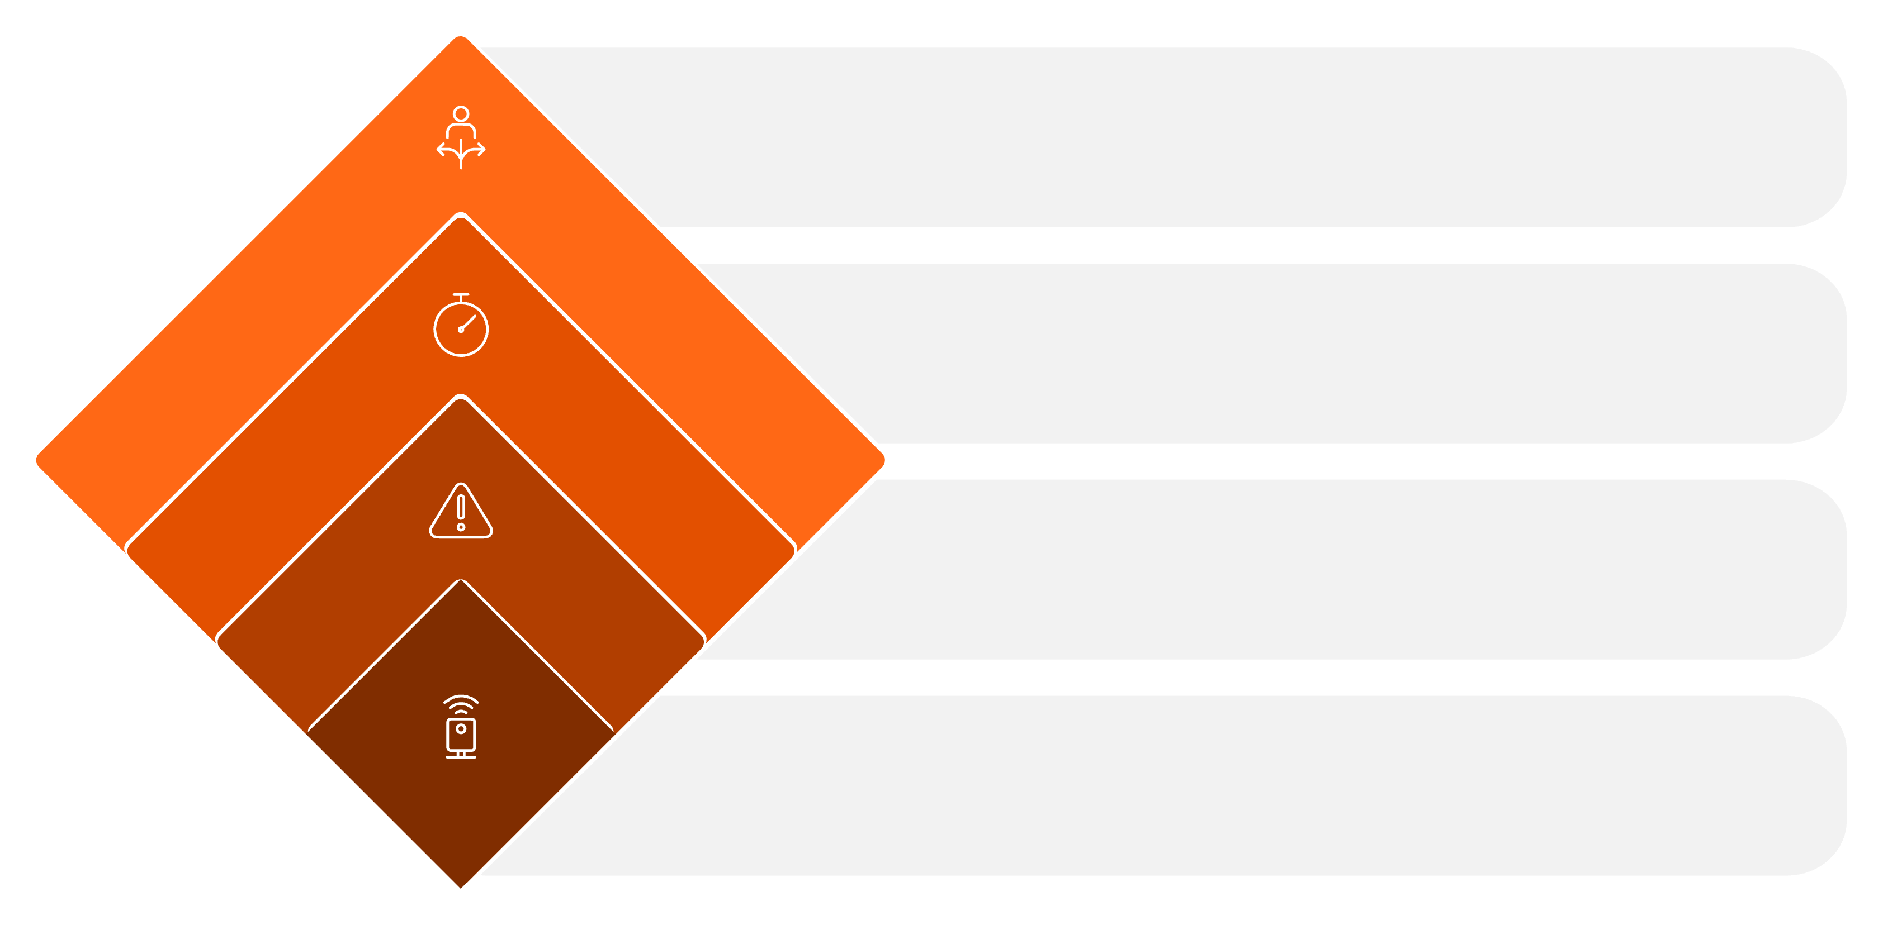
Working Mechanism (Workflow)
Rider Cancels?
No → trigger notifications
10s Countdown
Grace period for rider
Threshold Breach
Detects critical condition
Sensors Monitor
Continuously track status

Slide 10

Software & Algorithm
01
Accel, Gyro, Vibration
Preprocess
Sensor fusion & noise filtering.
Raw sensor inputs
02
Threshold Check
Filtering & Fusion
Acceleration & vibration thresholds.
SOS, Call, Log
Algorithm Flow
Trigger alerts and record
03
Noise reduction and combine
Confirm & Countdown
10s cancelable timer to avoid false alerts.
Debounce & Countdown
Threshold & Validation
04
Trigger
Cancelable 10s timer
Check limits and dual-validate
BLE message to phone; initiate emergency routines.

Slide 11



Automated Emergency Communication
Leveraging MacroDroid on the rider's mobile, the system intelligently adapts its alert strategy based on network availability, ensuring critical information reaches emergency contacts.
Online Mode (Network Available)
Offline Mode (No Network)
Telegram Alert
SIM Network Call
Automated call via Telegram and message to designated groups or personal accounts.
Initiate a direct call using the mobile's SIM network to emergency contacts.
Live Location Share
SMS with Coordinates
Share a live location link to provide real-time tracking for rescuers.
Send an SMS containing precise map coordinates and an accident notification.

Slide 12
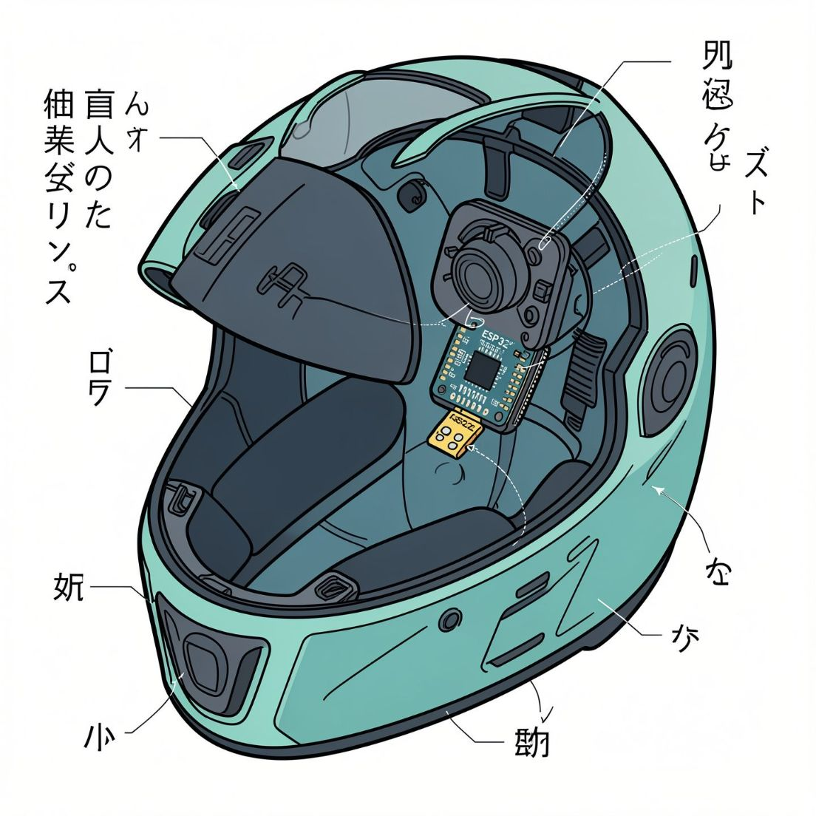
Implementation Design
ESP32 Placement
Sensor Mounting
Power
Battery with TP4056 in sealed compartment; external charging port.
Central, protected housing near rear for balance.
Rigid mount for MPU6050; damping for vibration sensor.
Circuitry
Low-noise traces, decoupling, and EMI shielding.

Slide 13

Conclusion
This smart helmet effectively integrates MPU6050 and SW-420 sensors with an ESP32 microcontroller to provide real-time motion and impact detection. Upon detecting an accident, it automatically communicates emergency alerts with precise location data to a connected mobile device.
Its modular design allows for flexible customization, enabling optional features such as advanced GPS tracking, audible warnings, and clear visual indicators. This project showcases a cost-effective and practical DIY IoT solution that significantly enhances rider safety by seamlessly combining traditional protective gear with modern technology.

